Slide 1
Pend Oreille PUD Fleet

Slide 2
Trucks or Bucket Trucks with a GVW of less than 26,000 lbs.
Diesel powered vehicles should be replaced at no more than ten years 150,000 miles, accumulative PTO hours of 5,000 or total engine hours/idle time of 7,500 hours, whichever comes first unless the vehicle is deemed fit for service by the Director of Operations or General Manager
Trucks with a GVW greater than 26,000 lbs.
If one or more of the following criteria exceeds their maximum allowable limit, the vehicle should be replaced: no more than ten years of service with no regard to mileage, accumulative PTO hours exceeding 5,000 or total engine hours/idle time exceeding 7,500 hours, whichever comes first unless the vehicle is deemed fit for service by the Director of Operations or General Manager

Slide 3
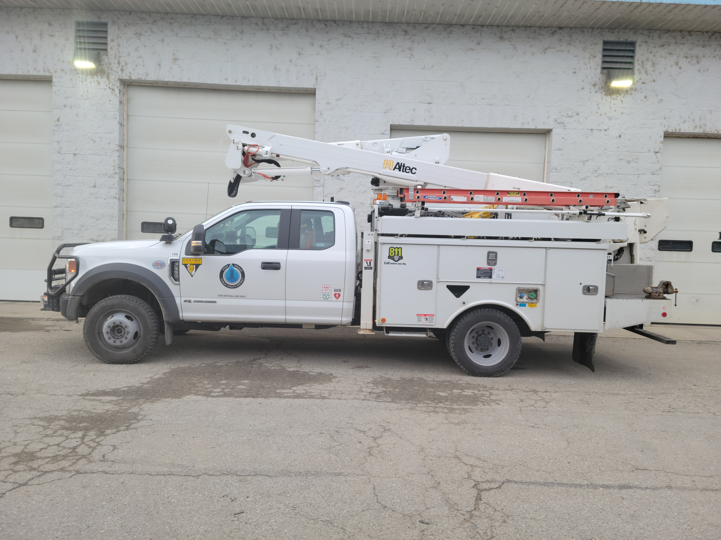
2020

Slide 4
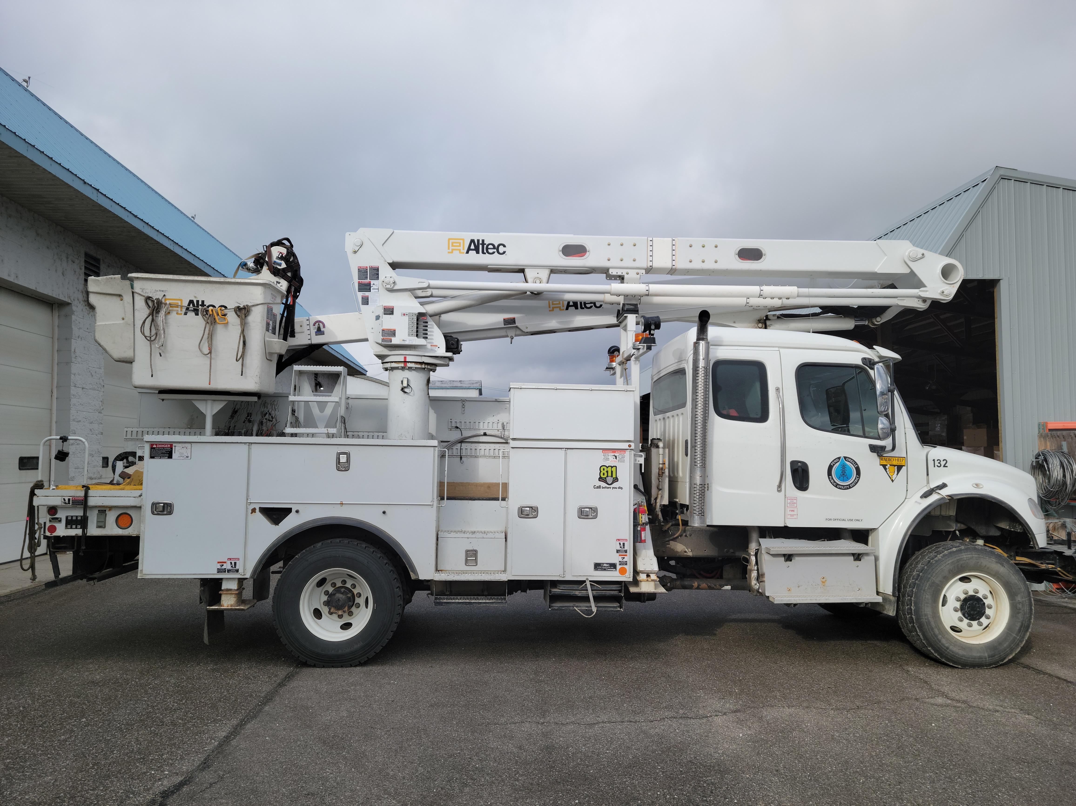
2016

Slide 5
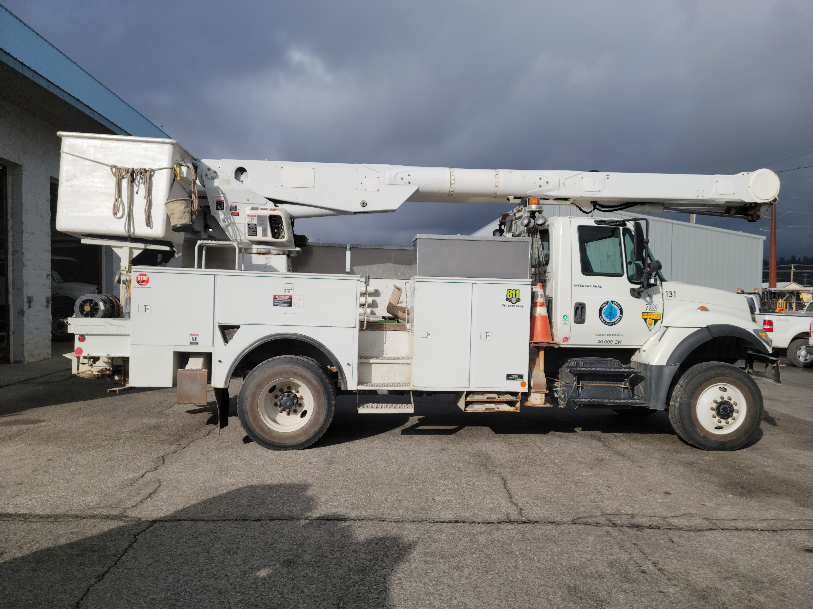
2007

Slide 6
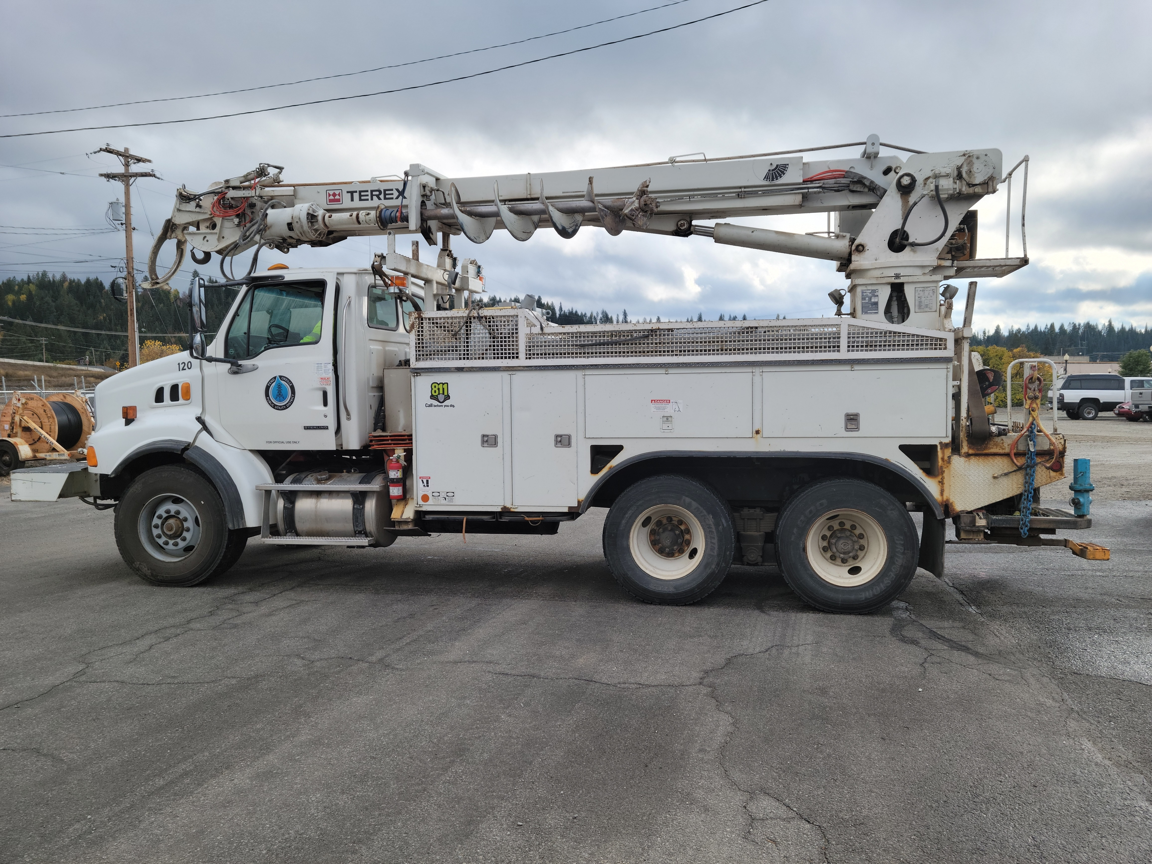
2008

Slide 7
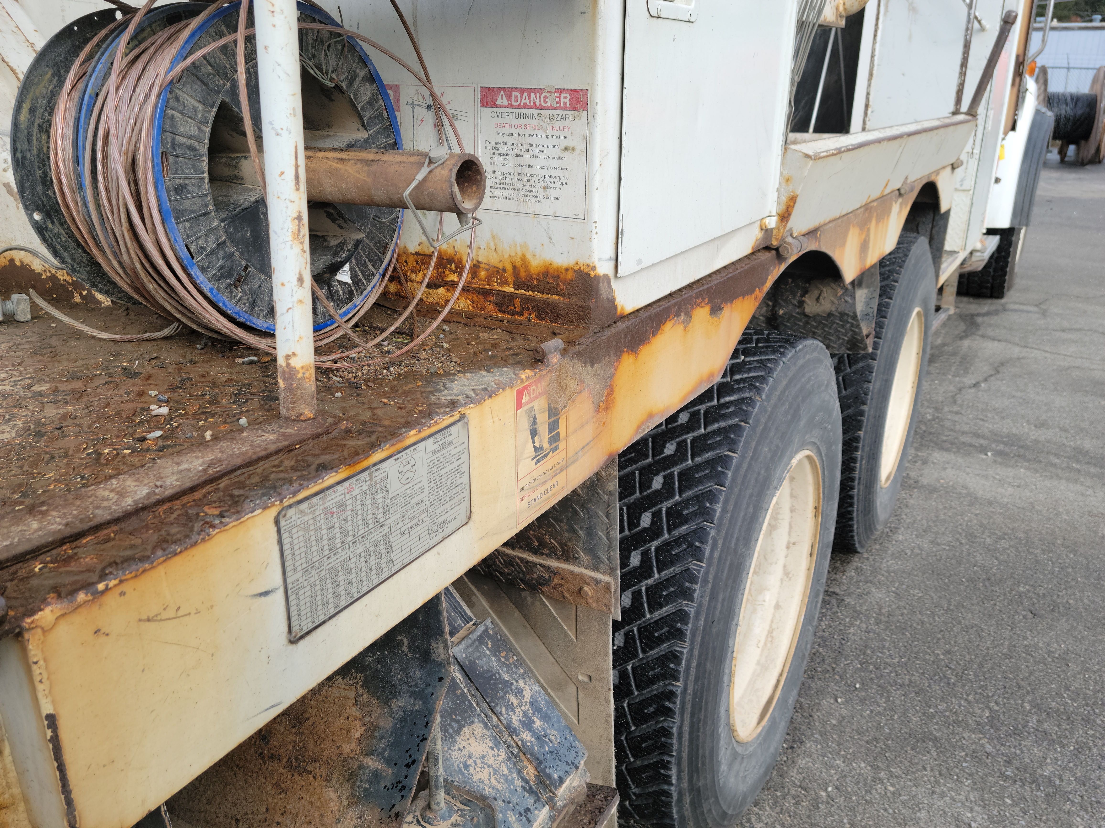
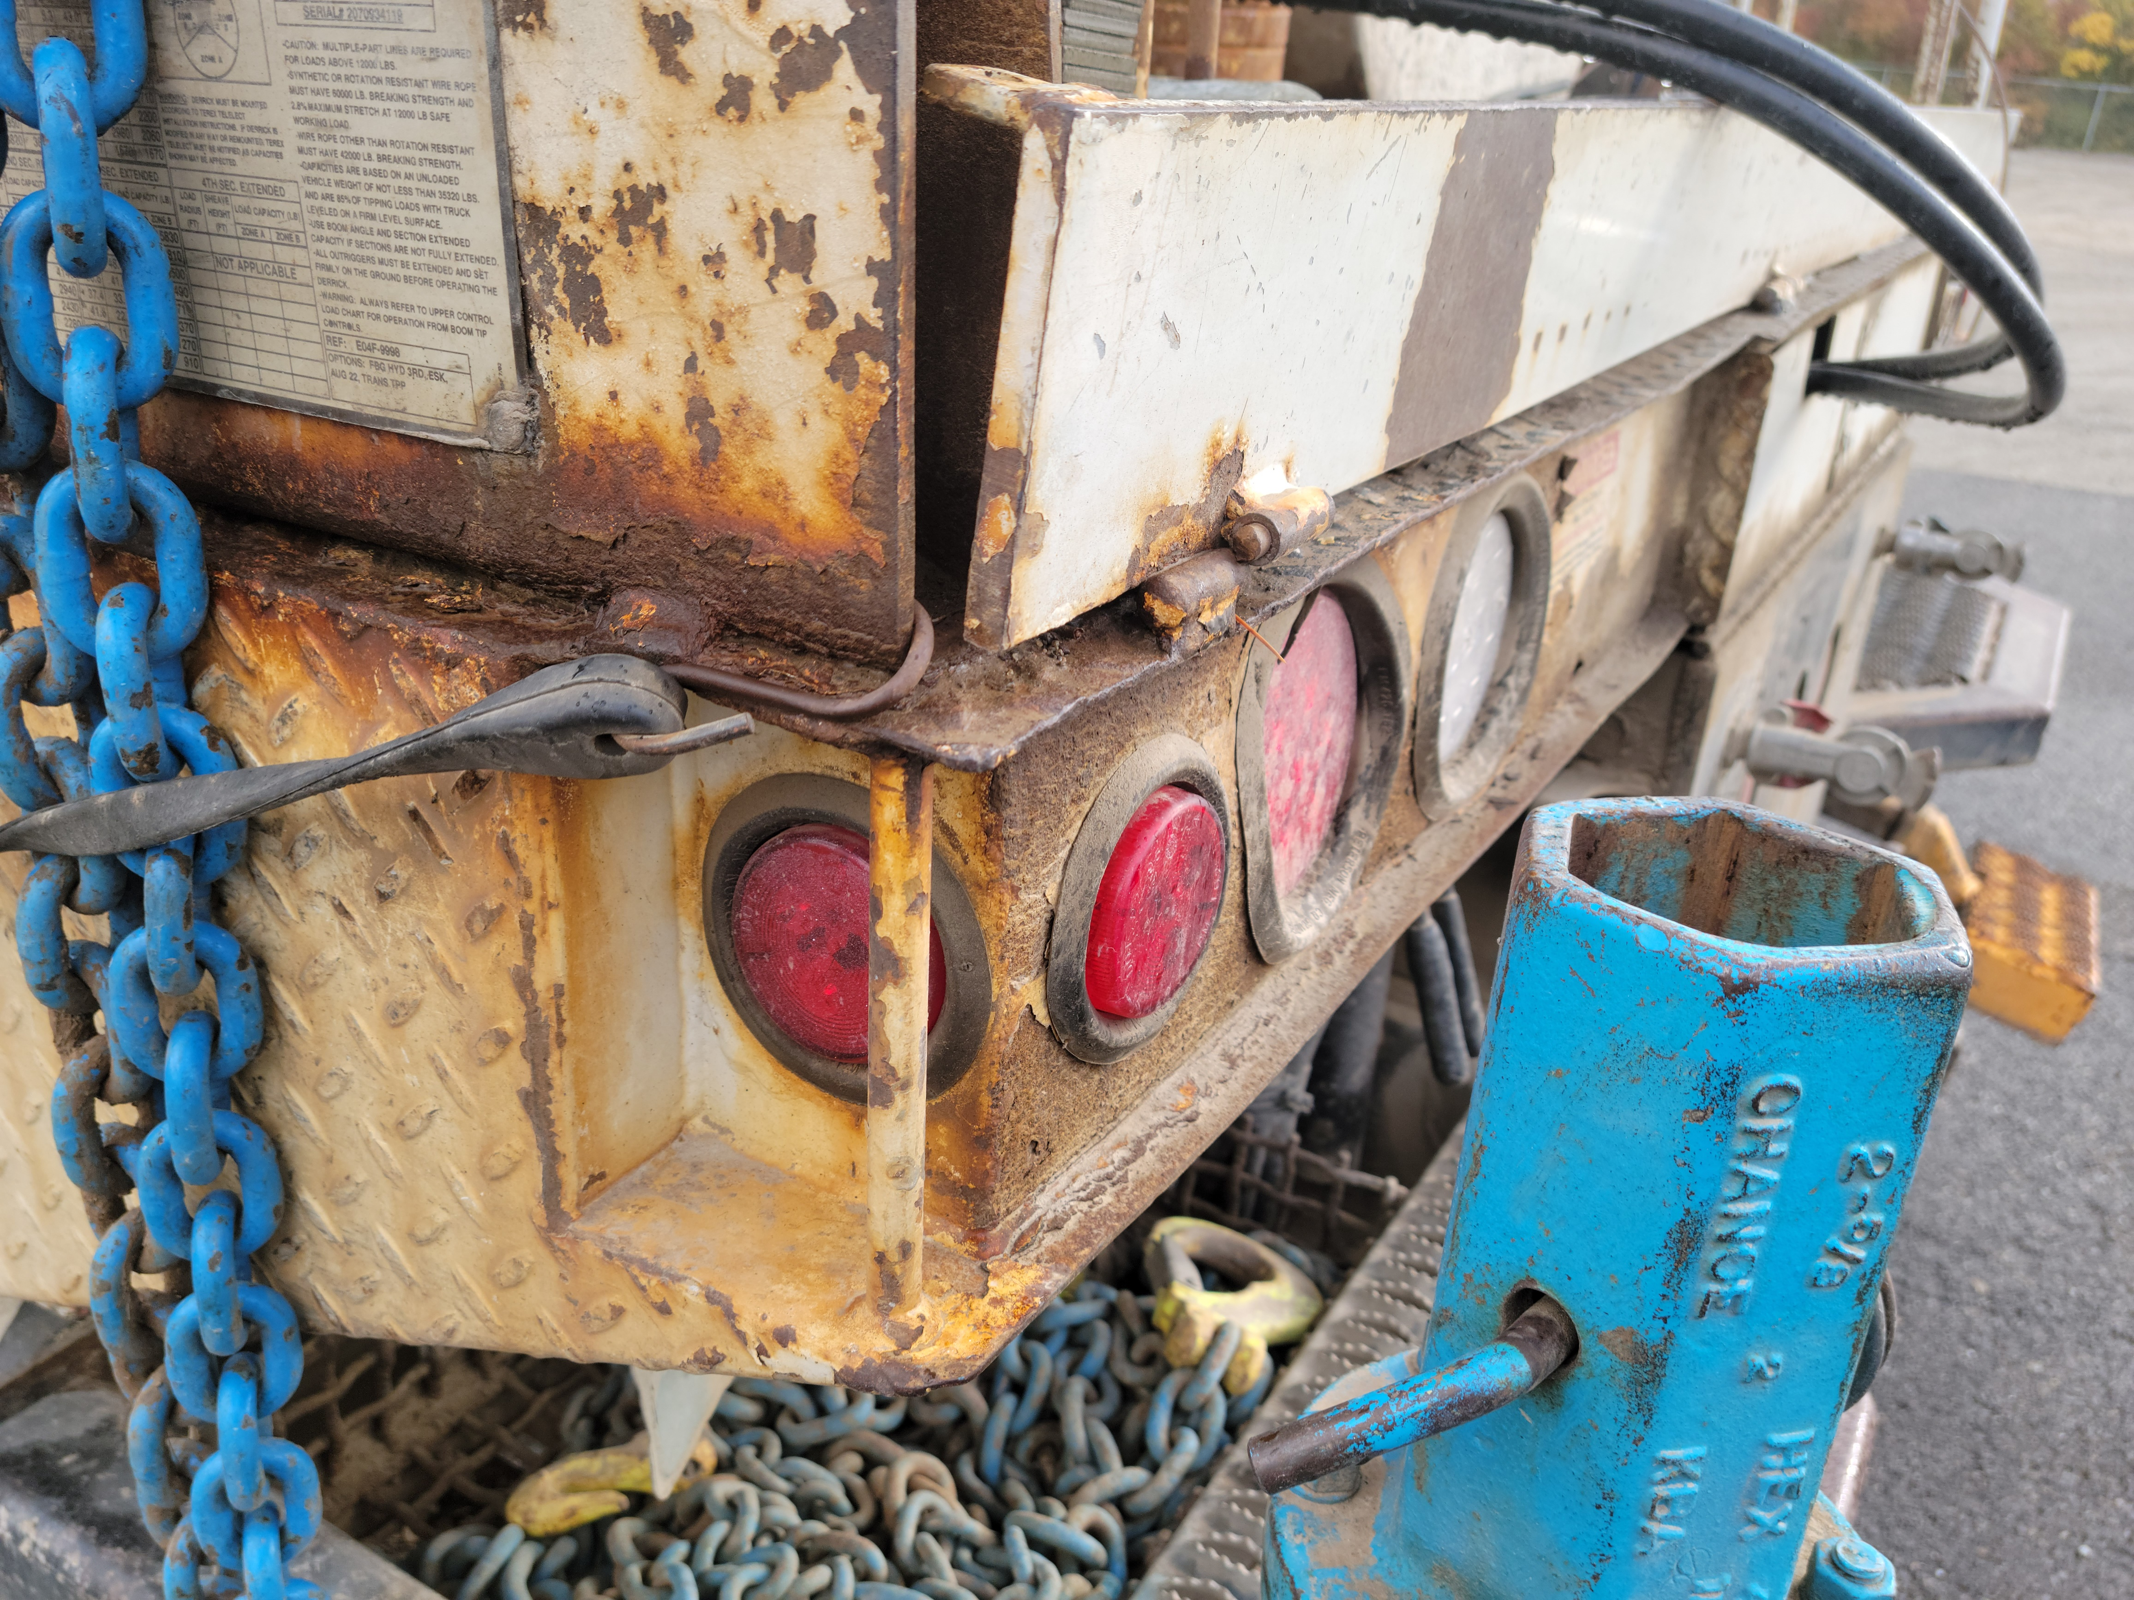

Slide 8
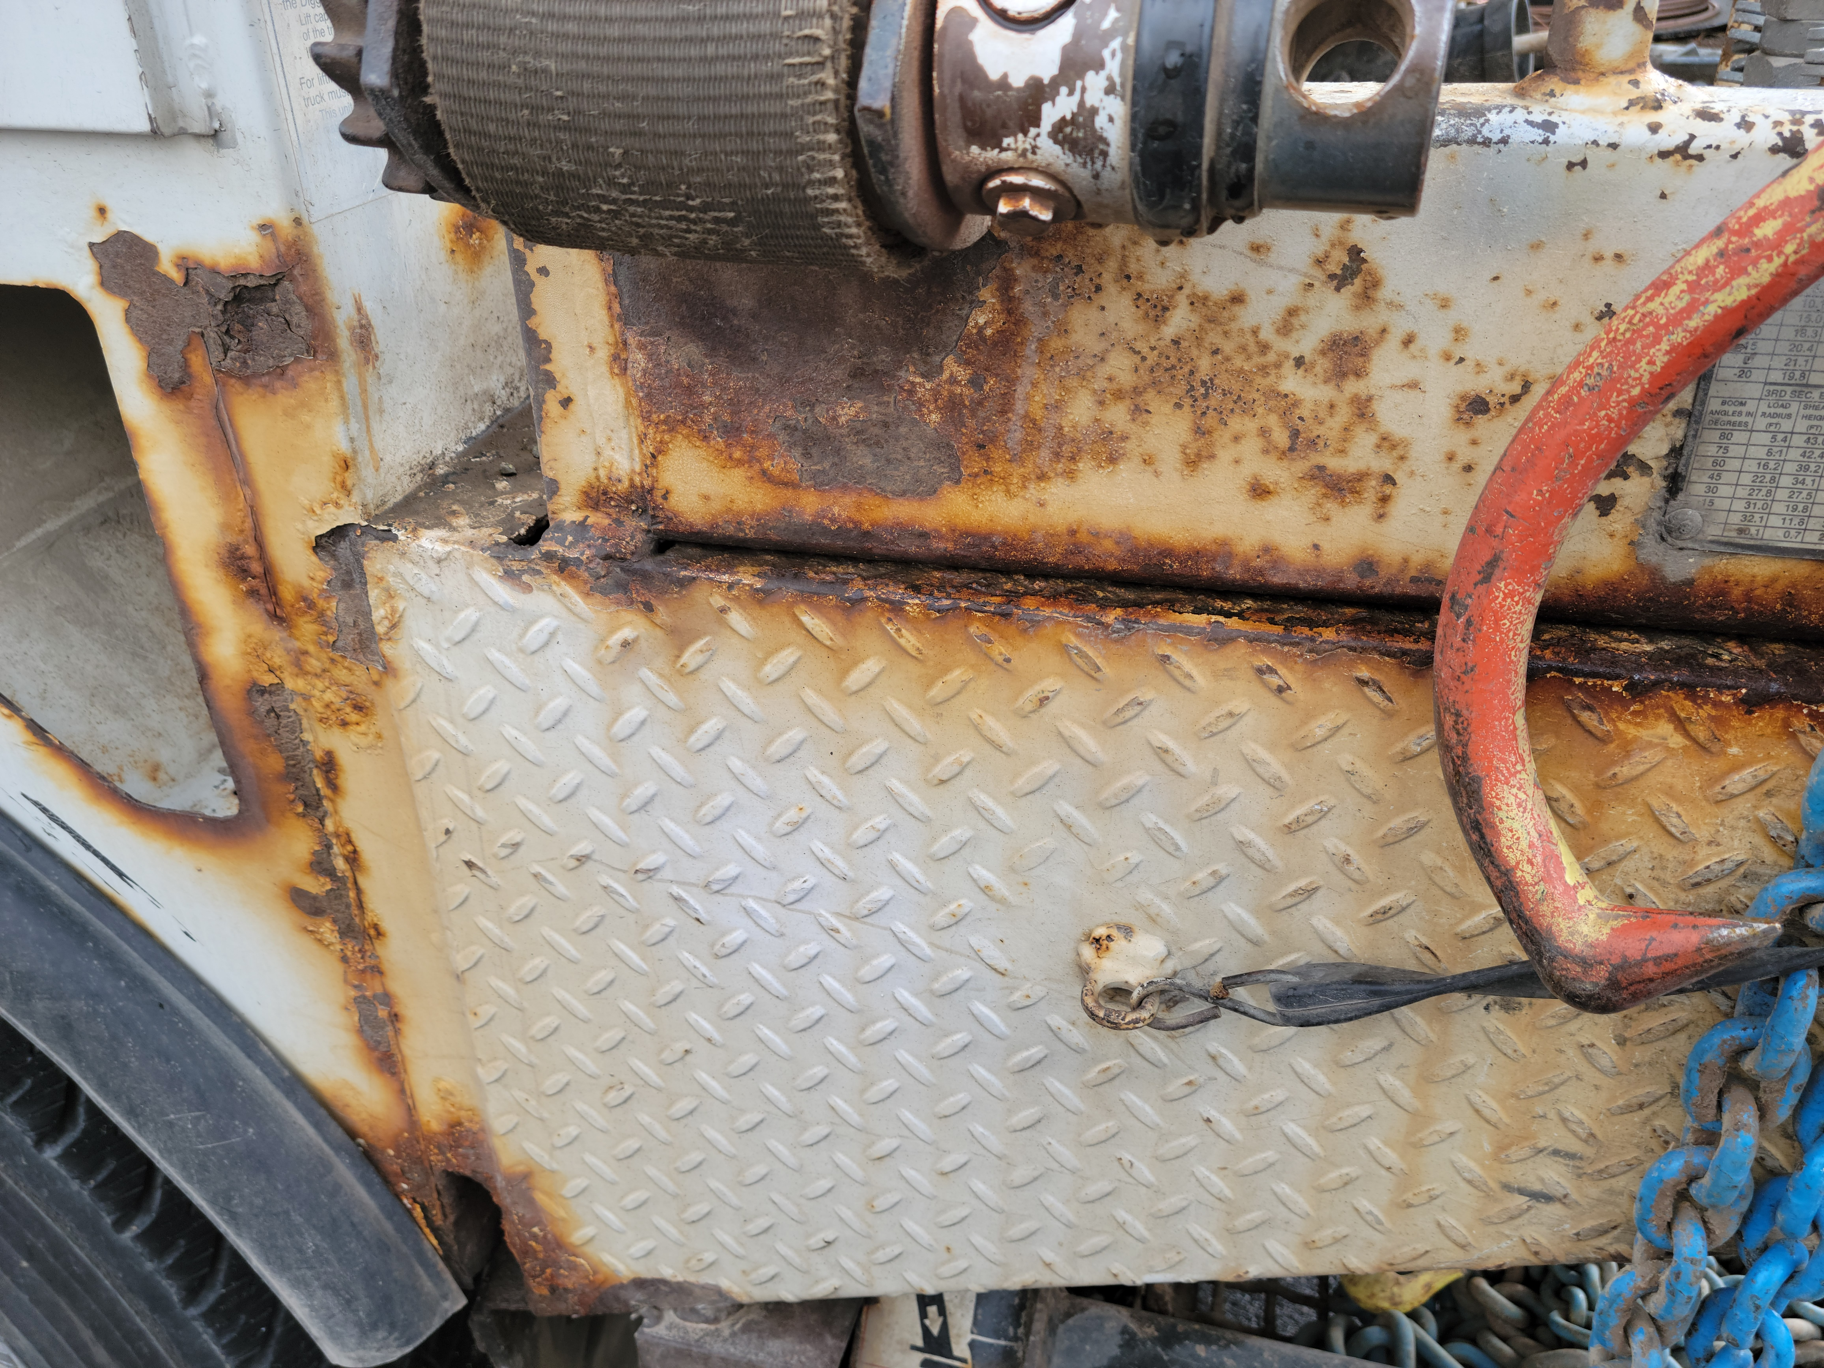

Slide 9
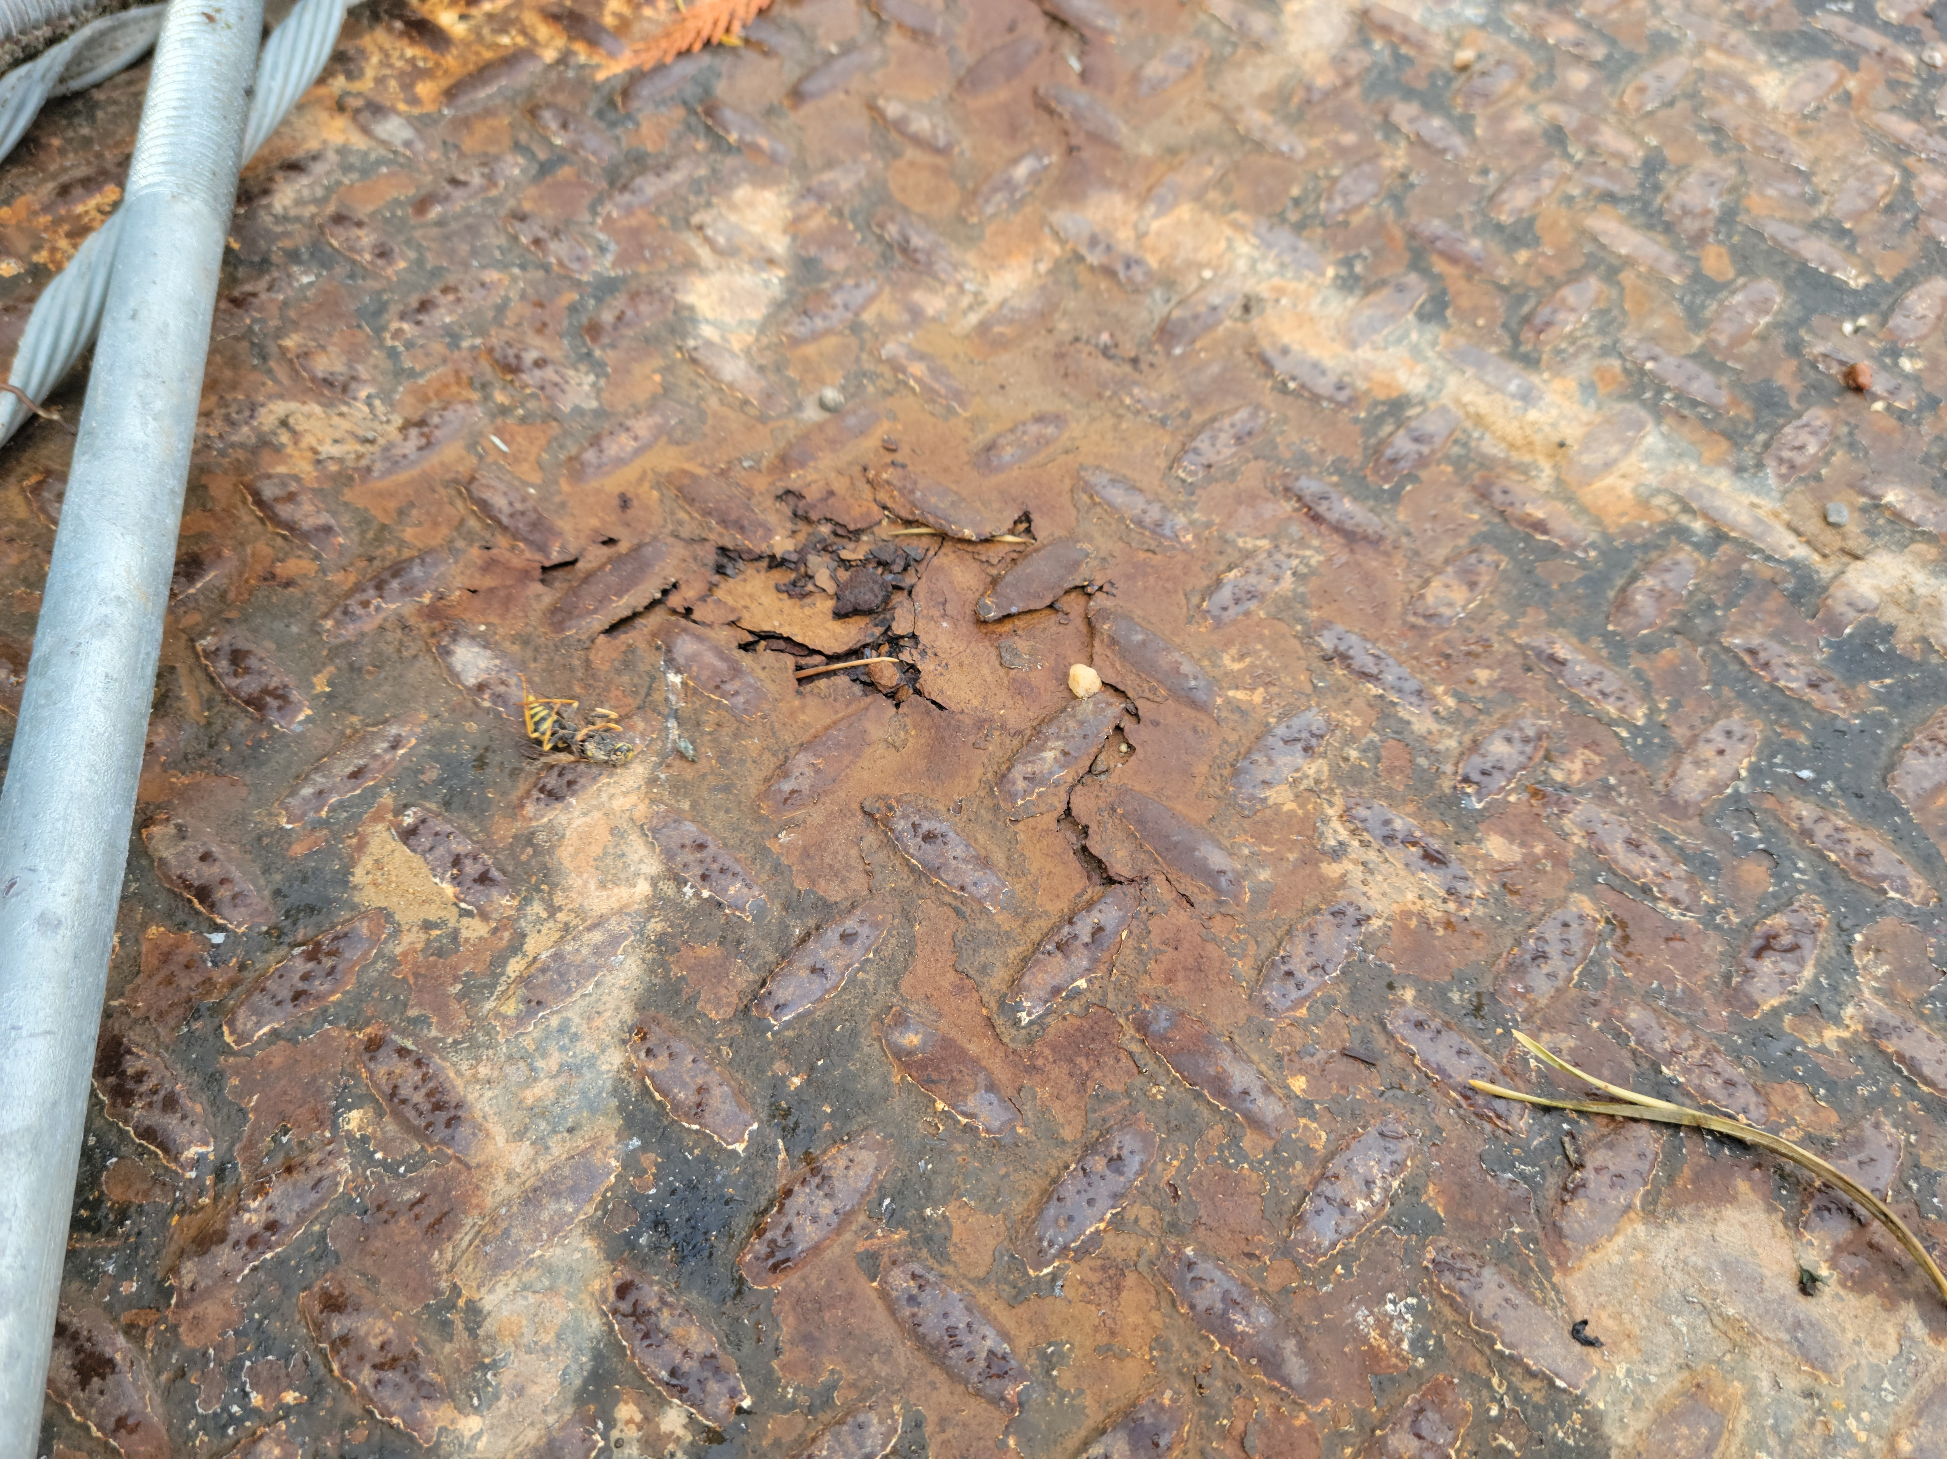
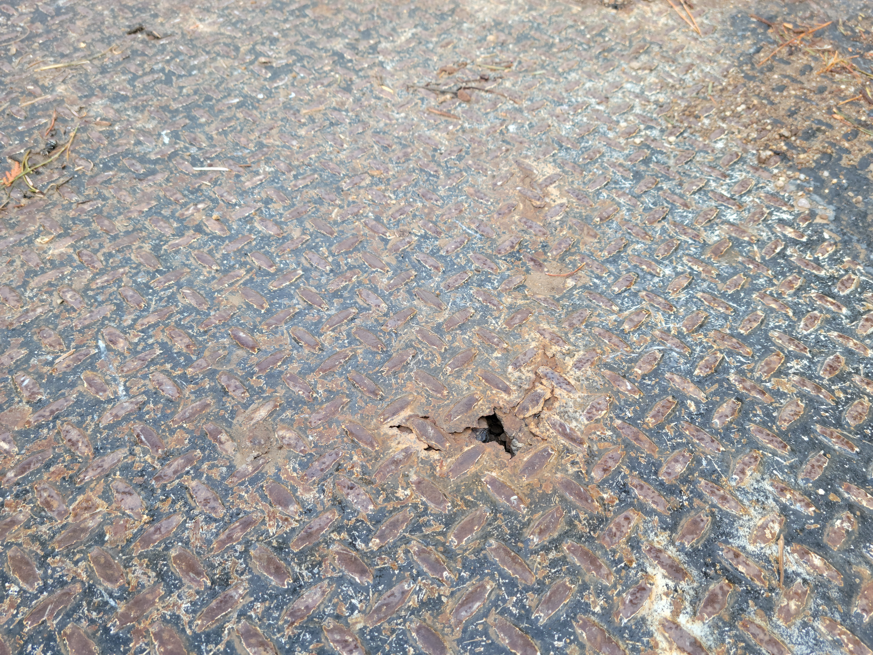

Slide 10
2007

Slide 11
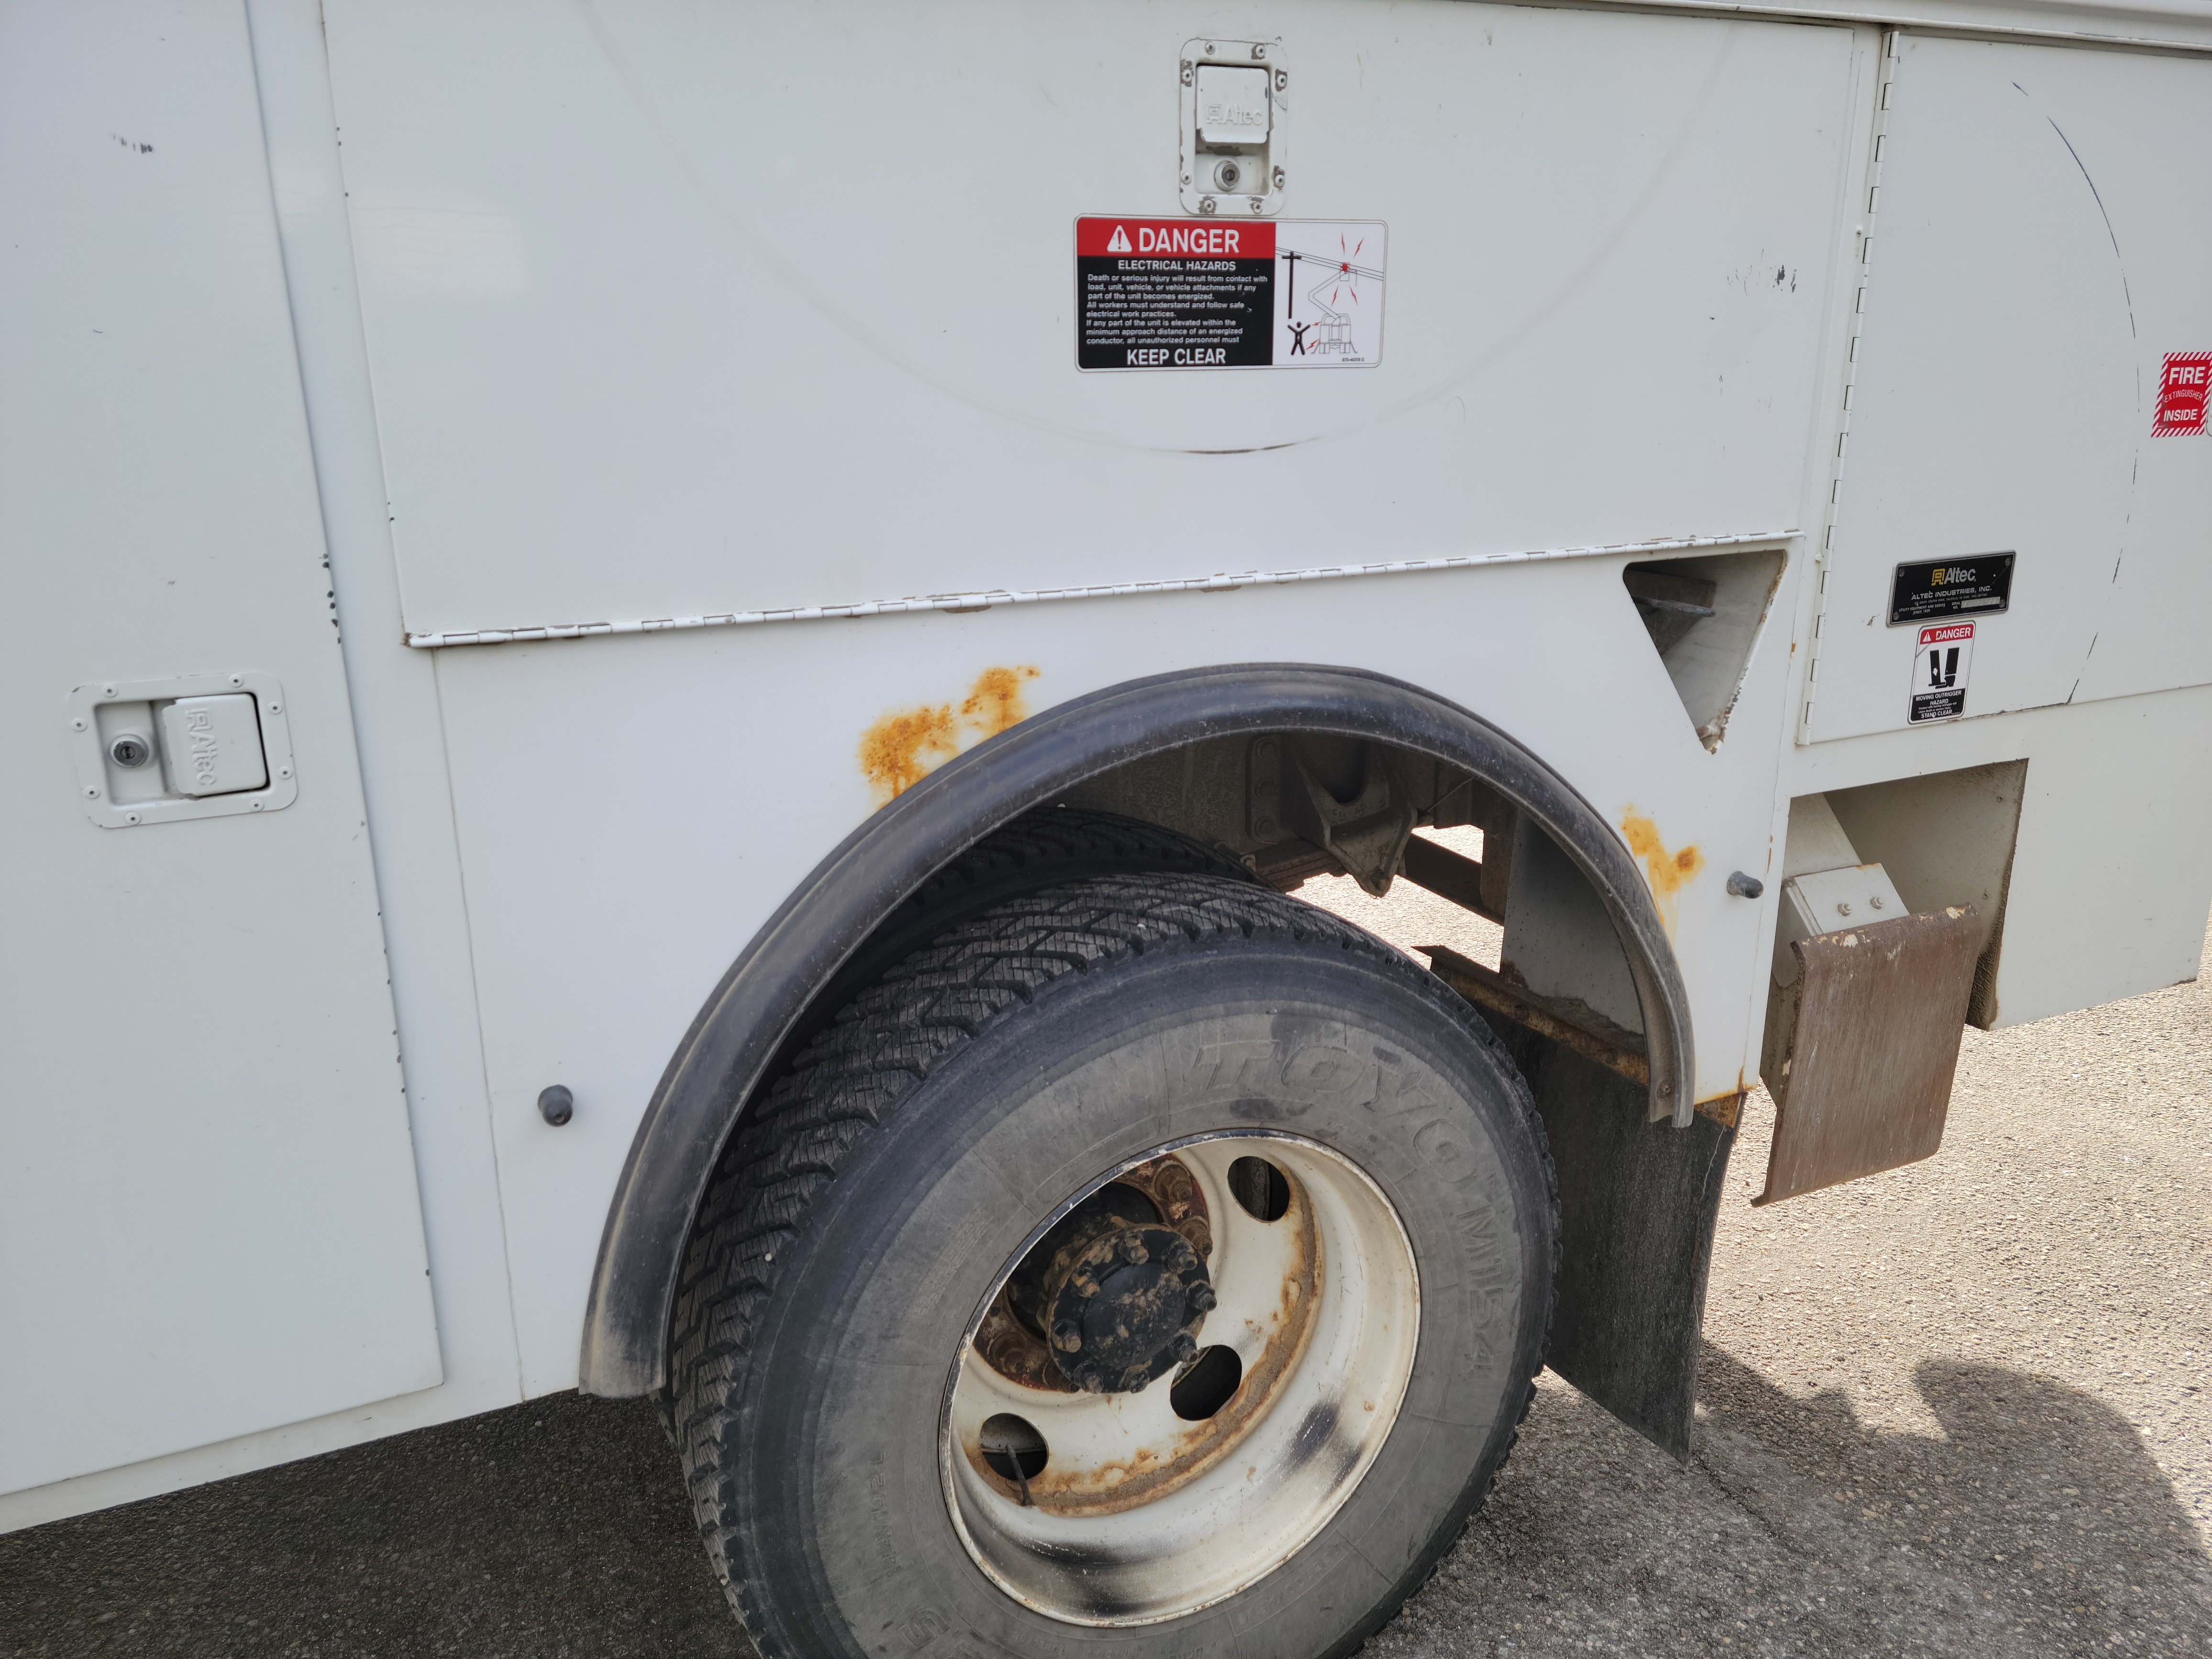
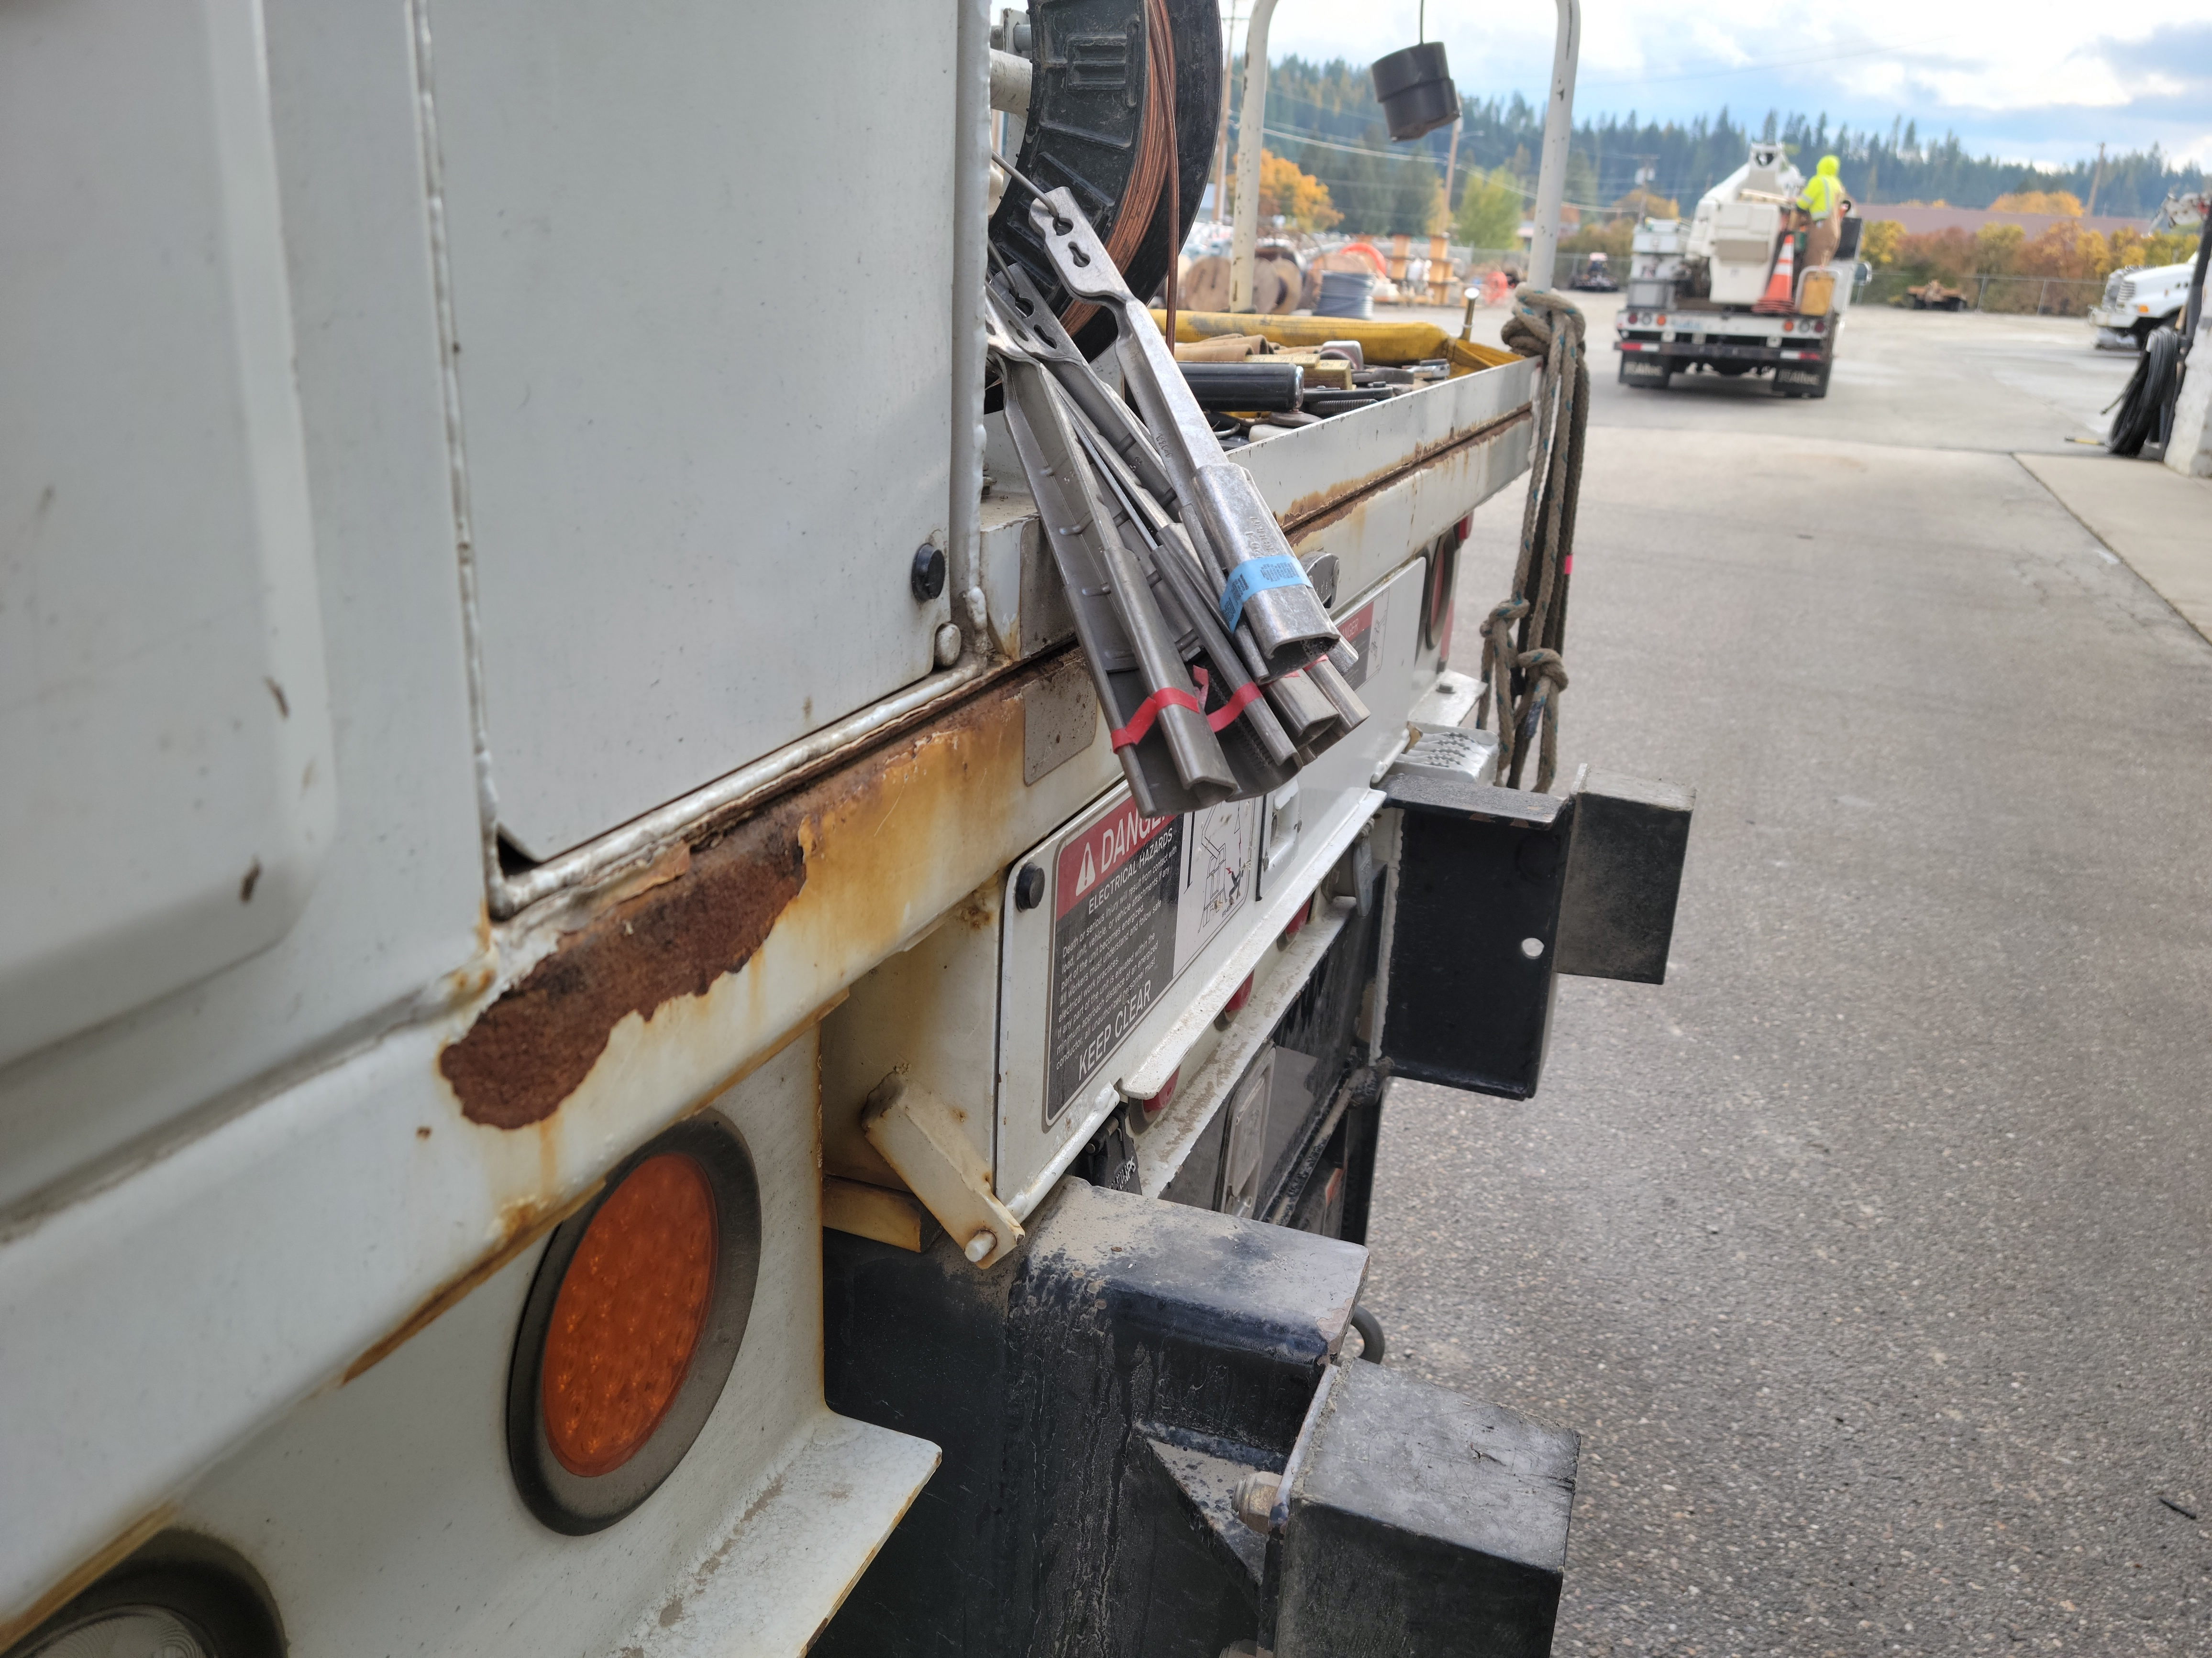

Slide 12
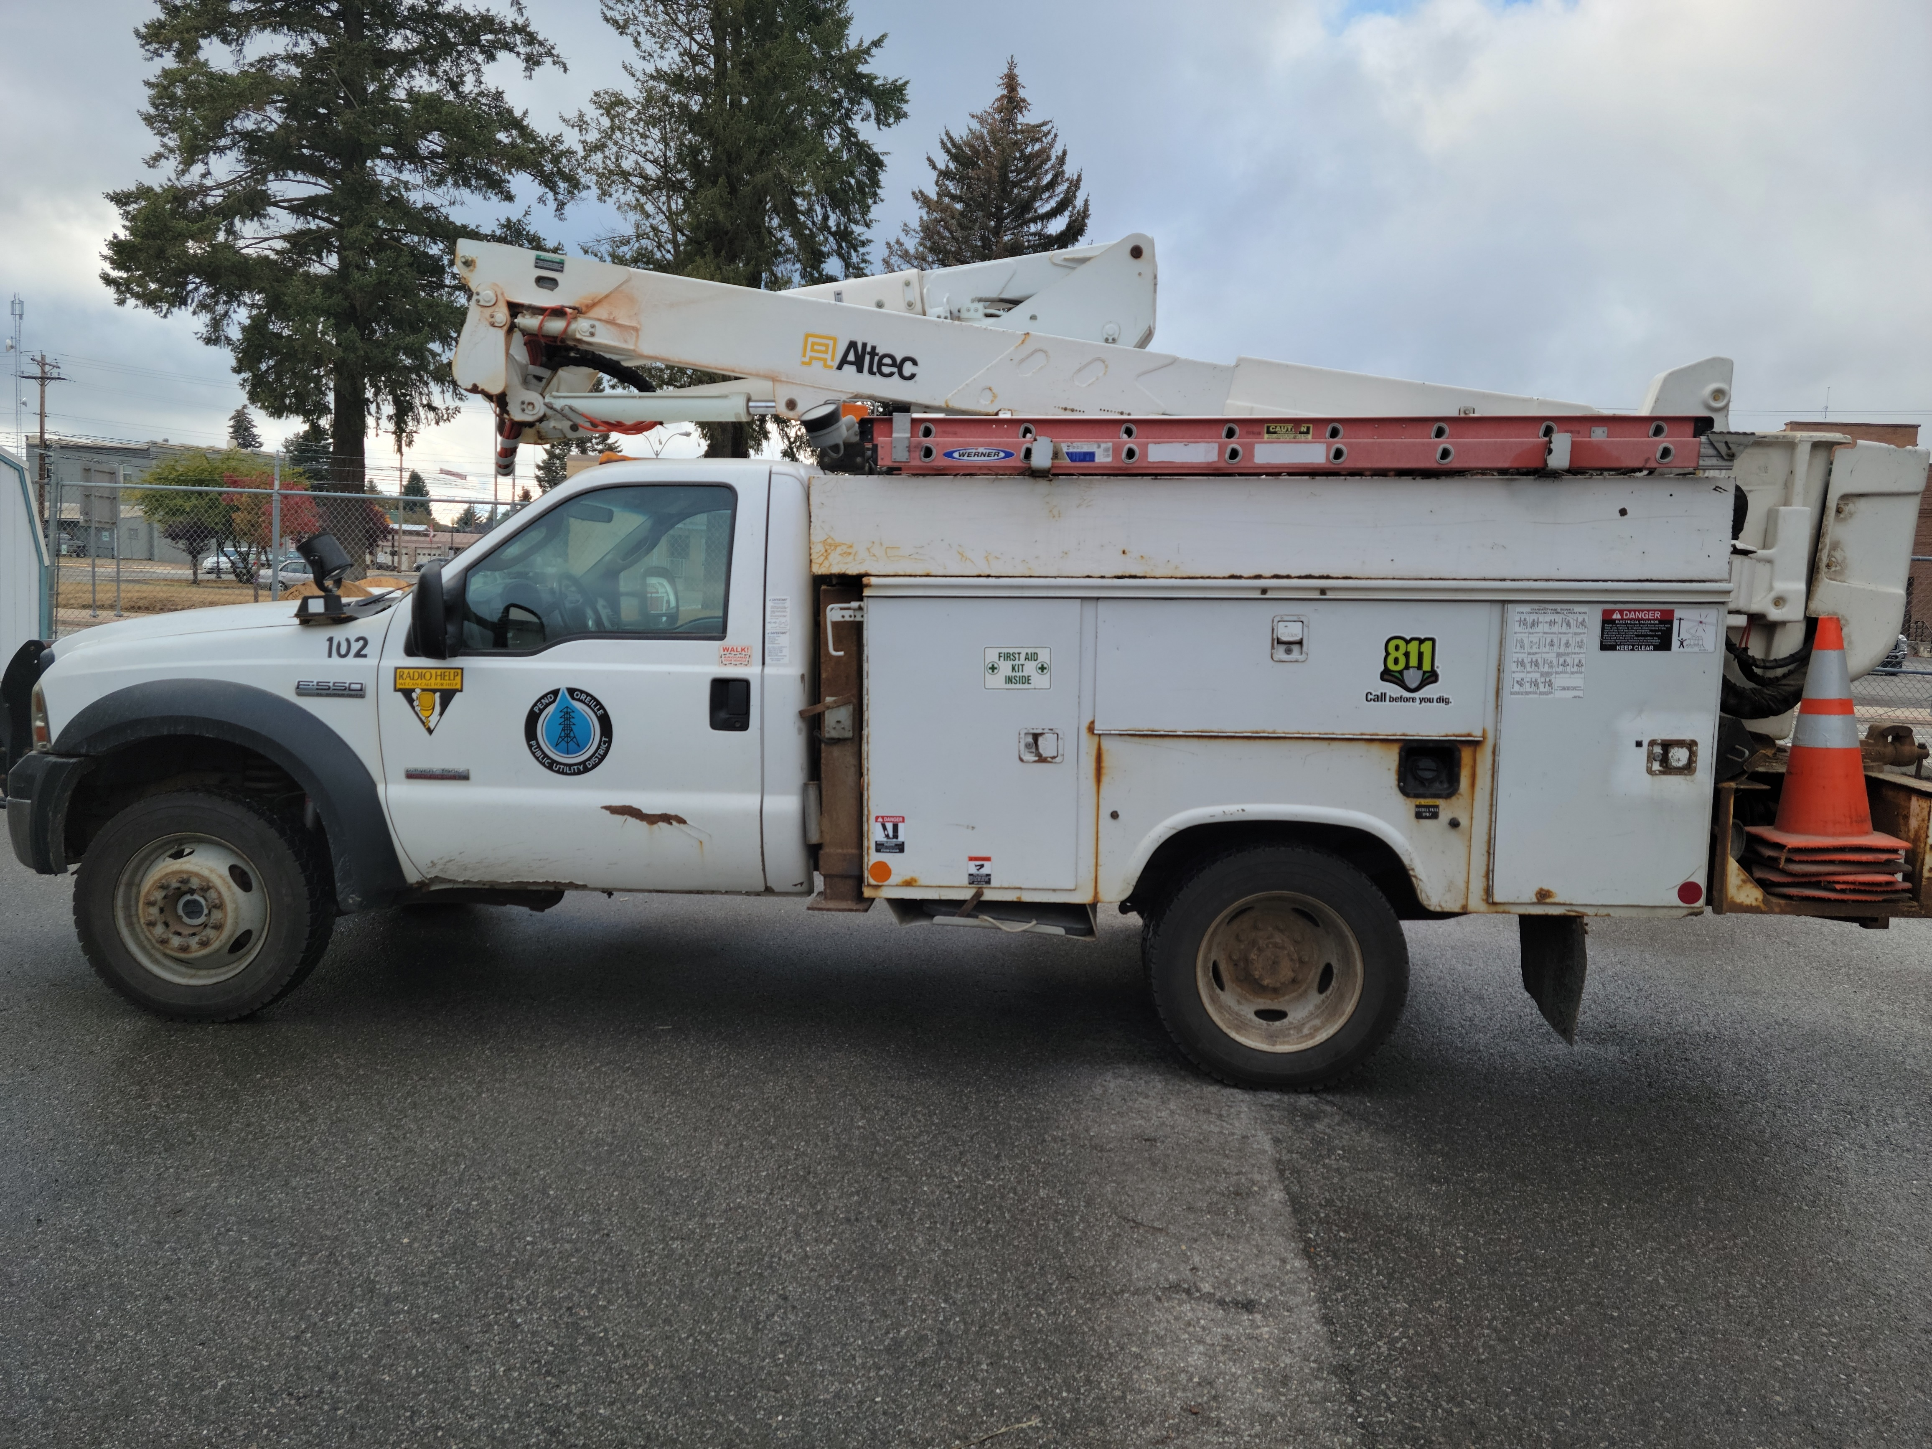
2007 246,000

Slide 13
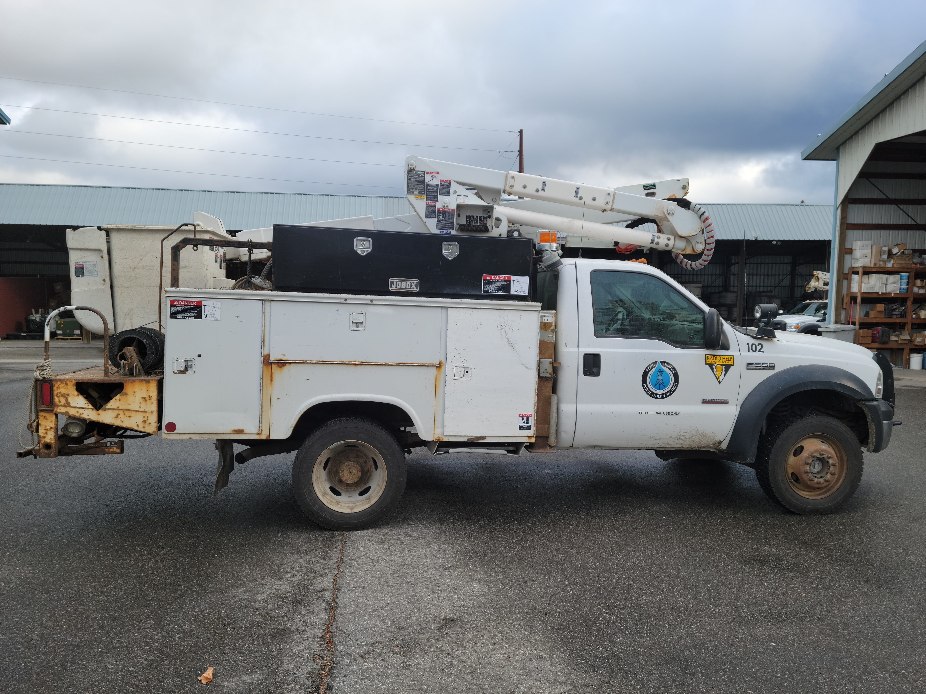
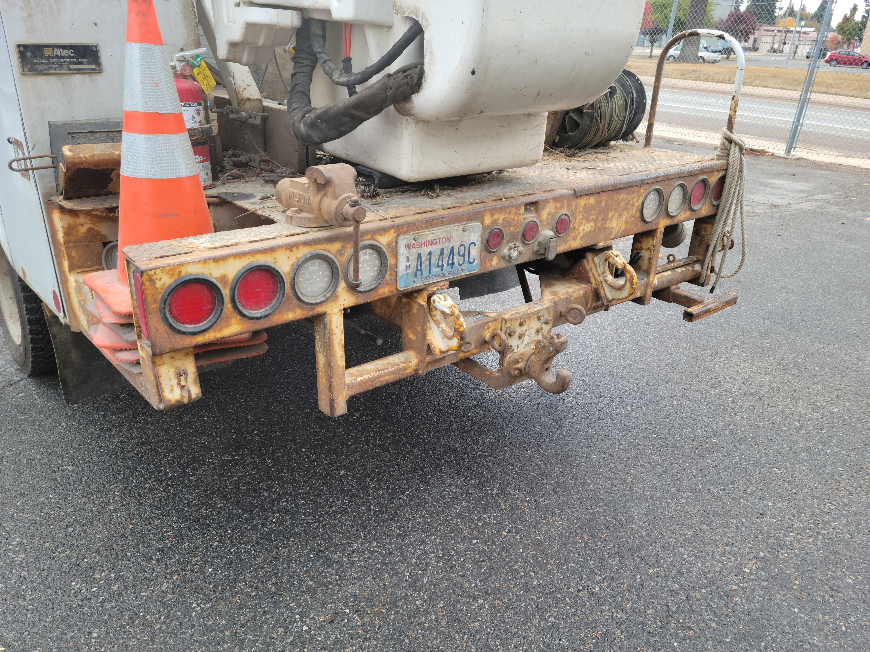

Slide 14
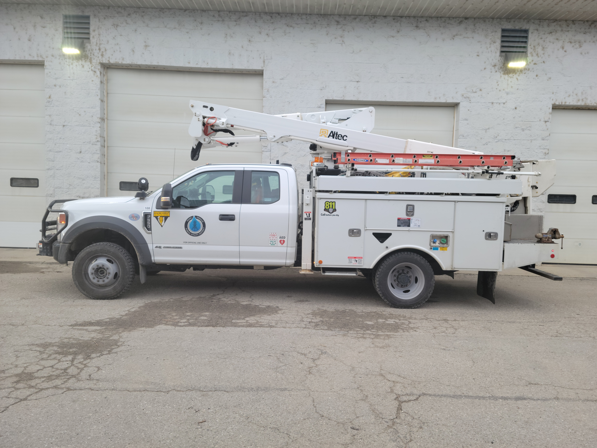

Slide 15
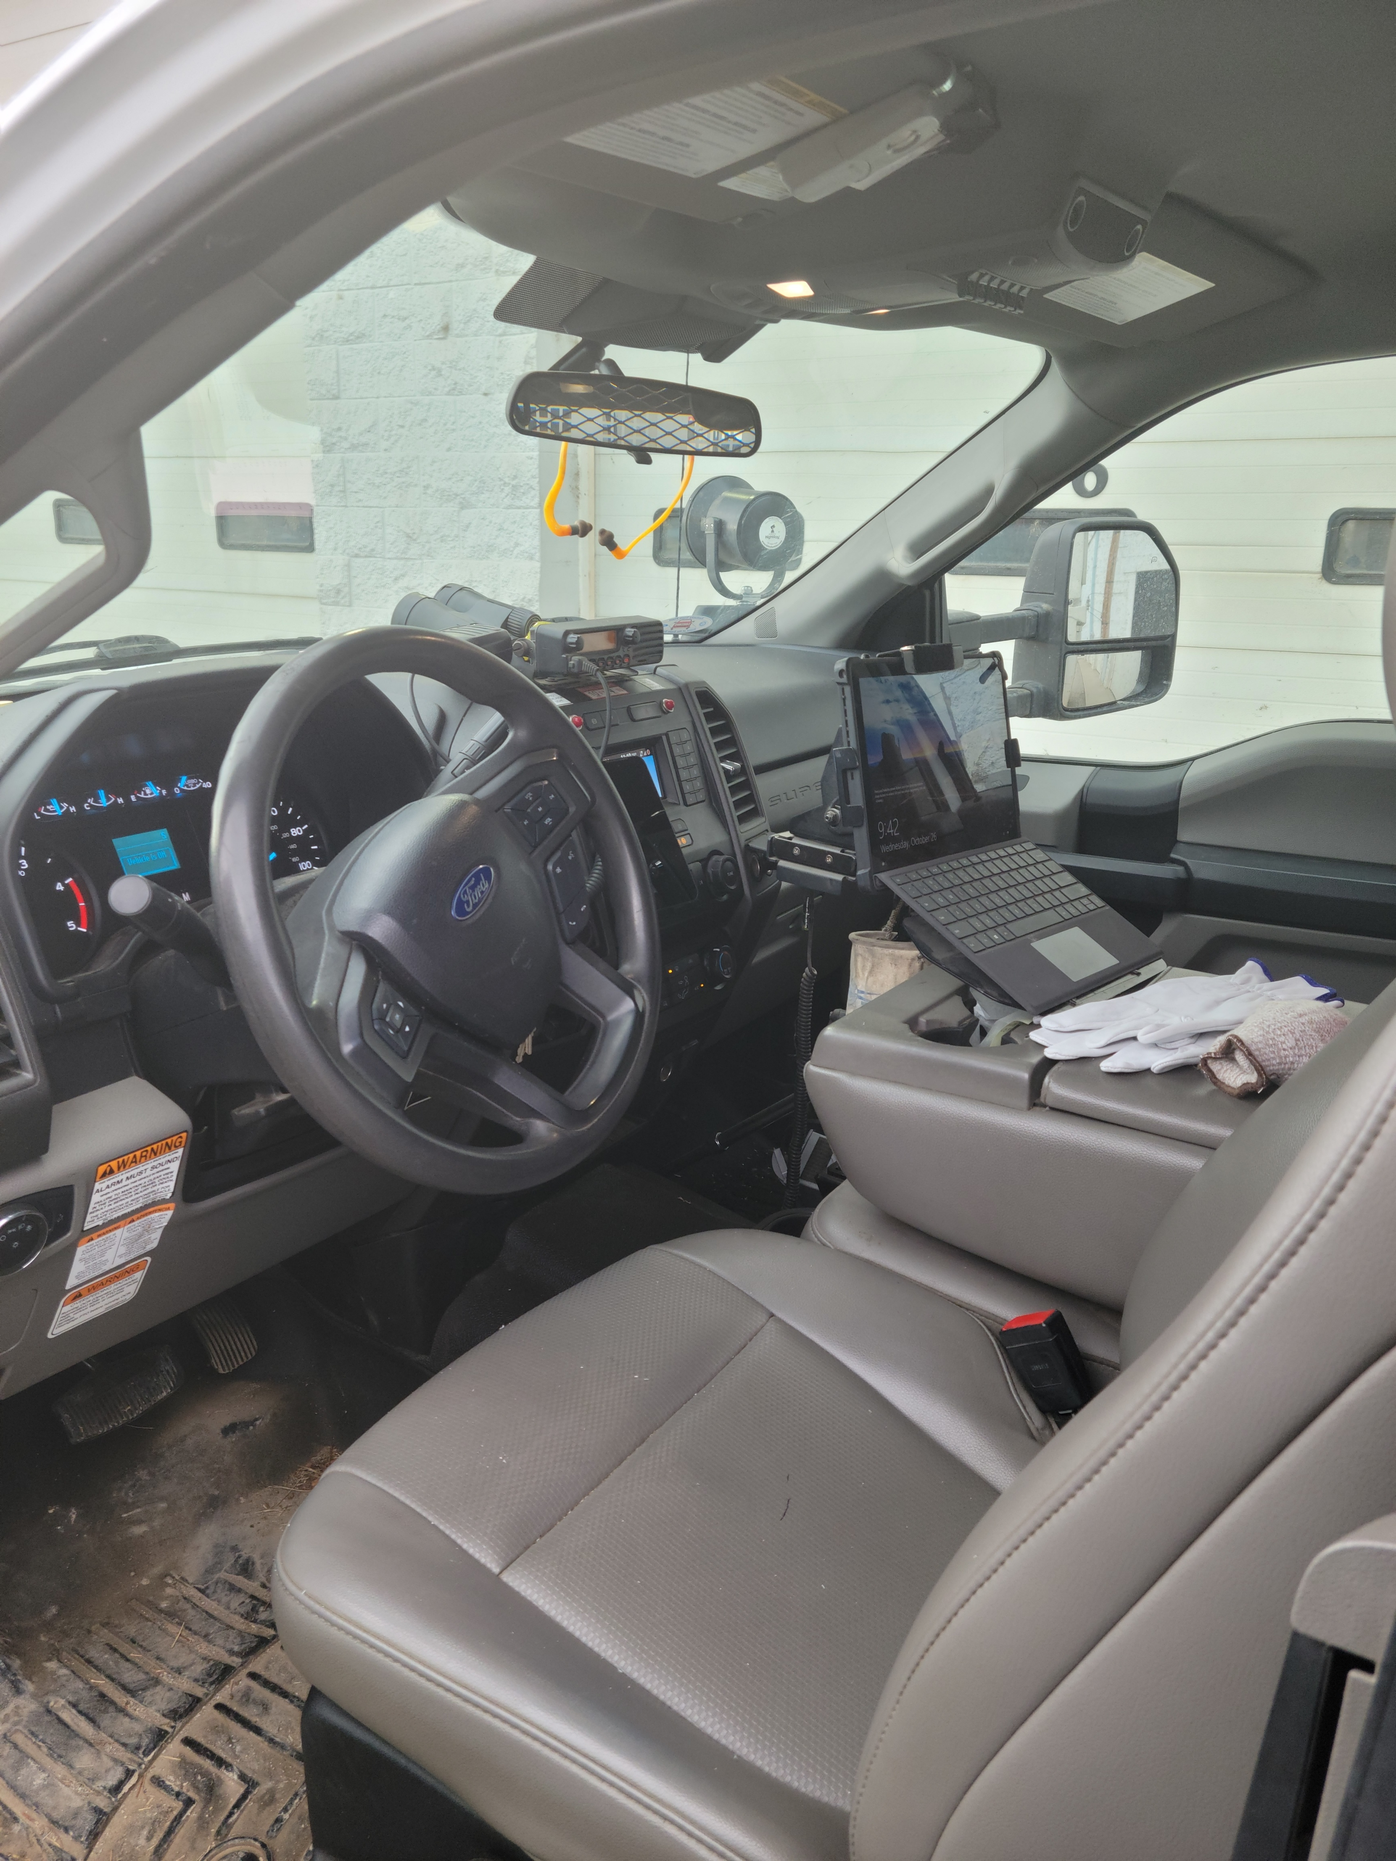
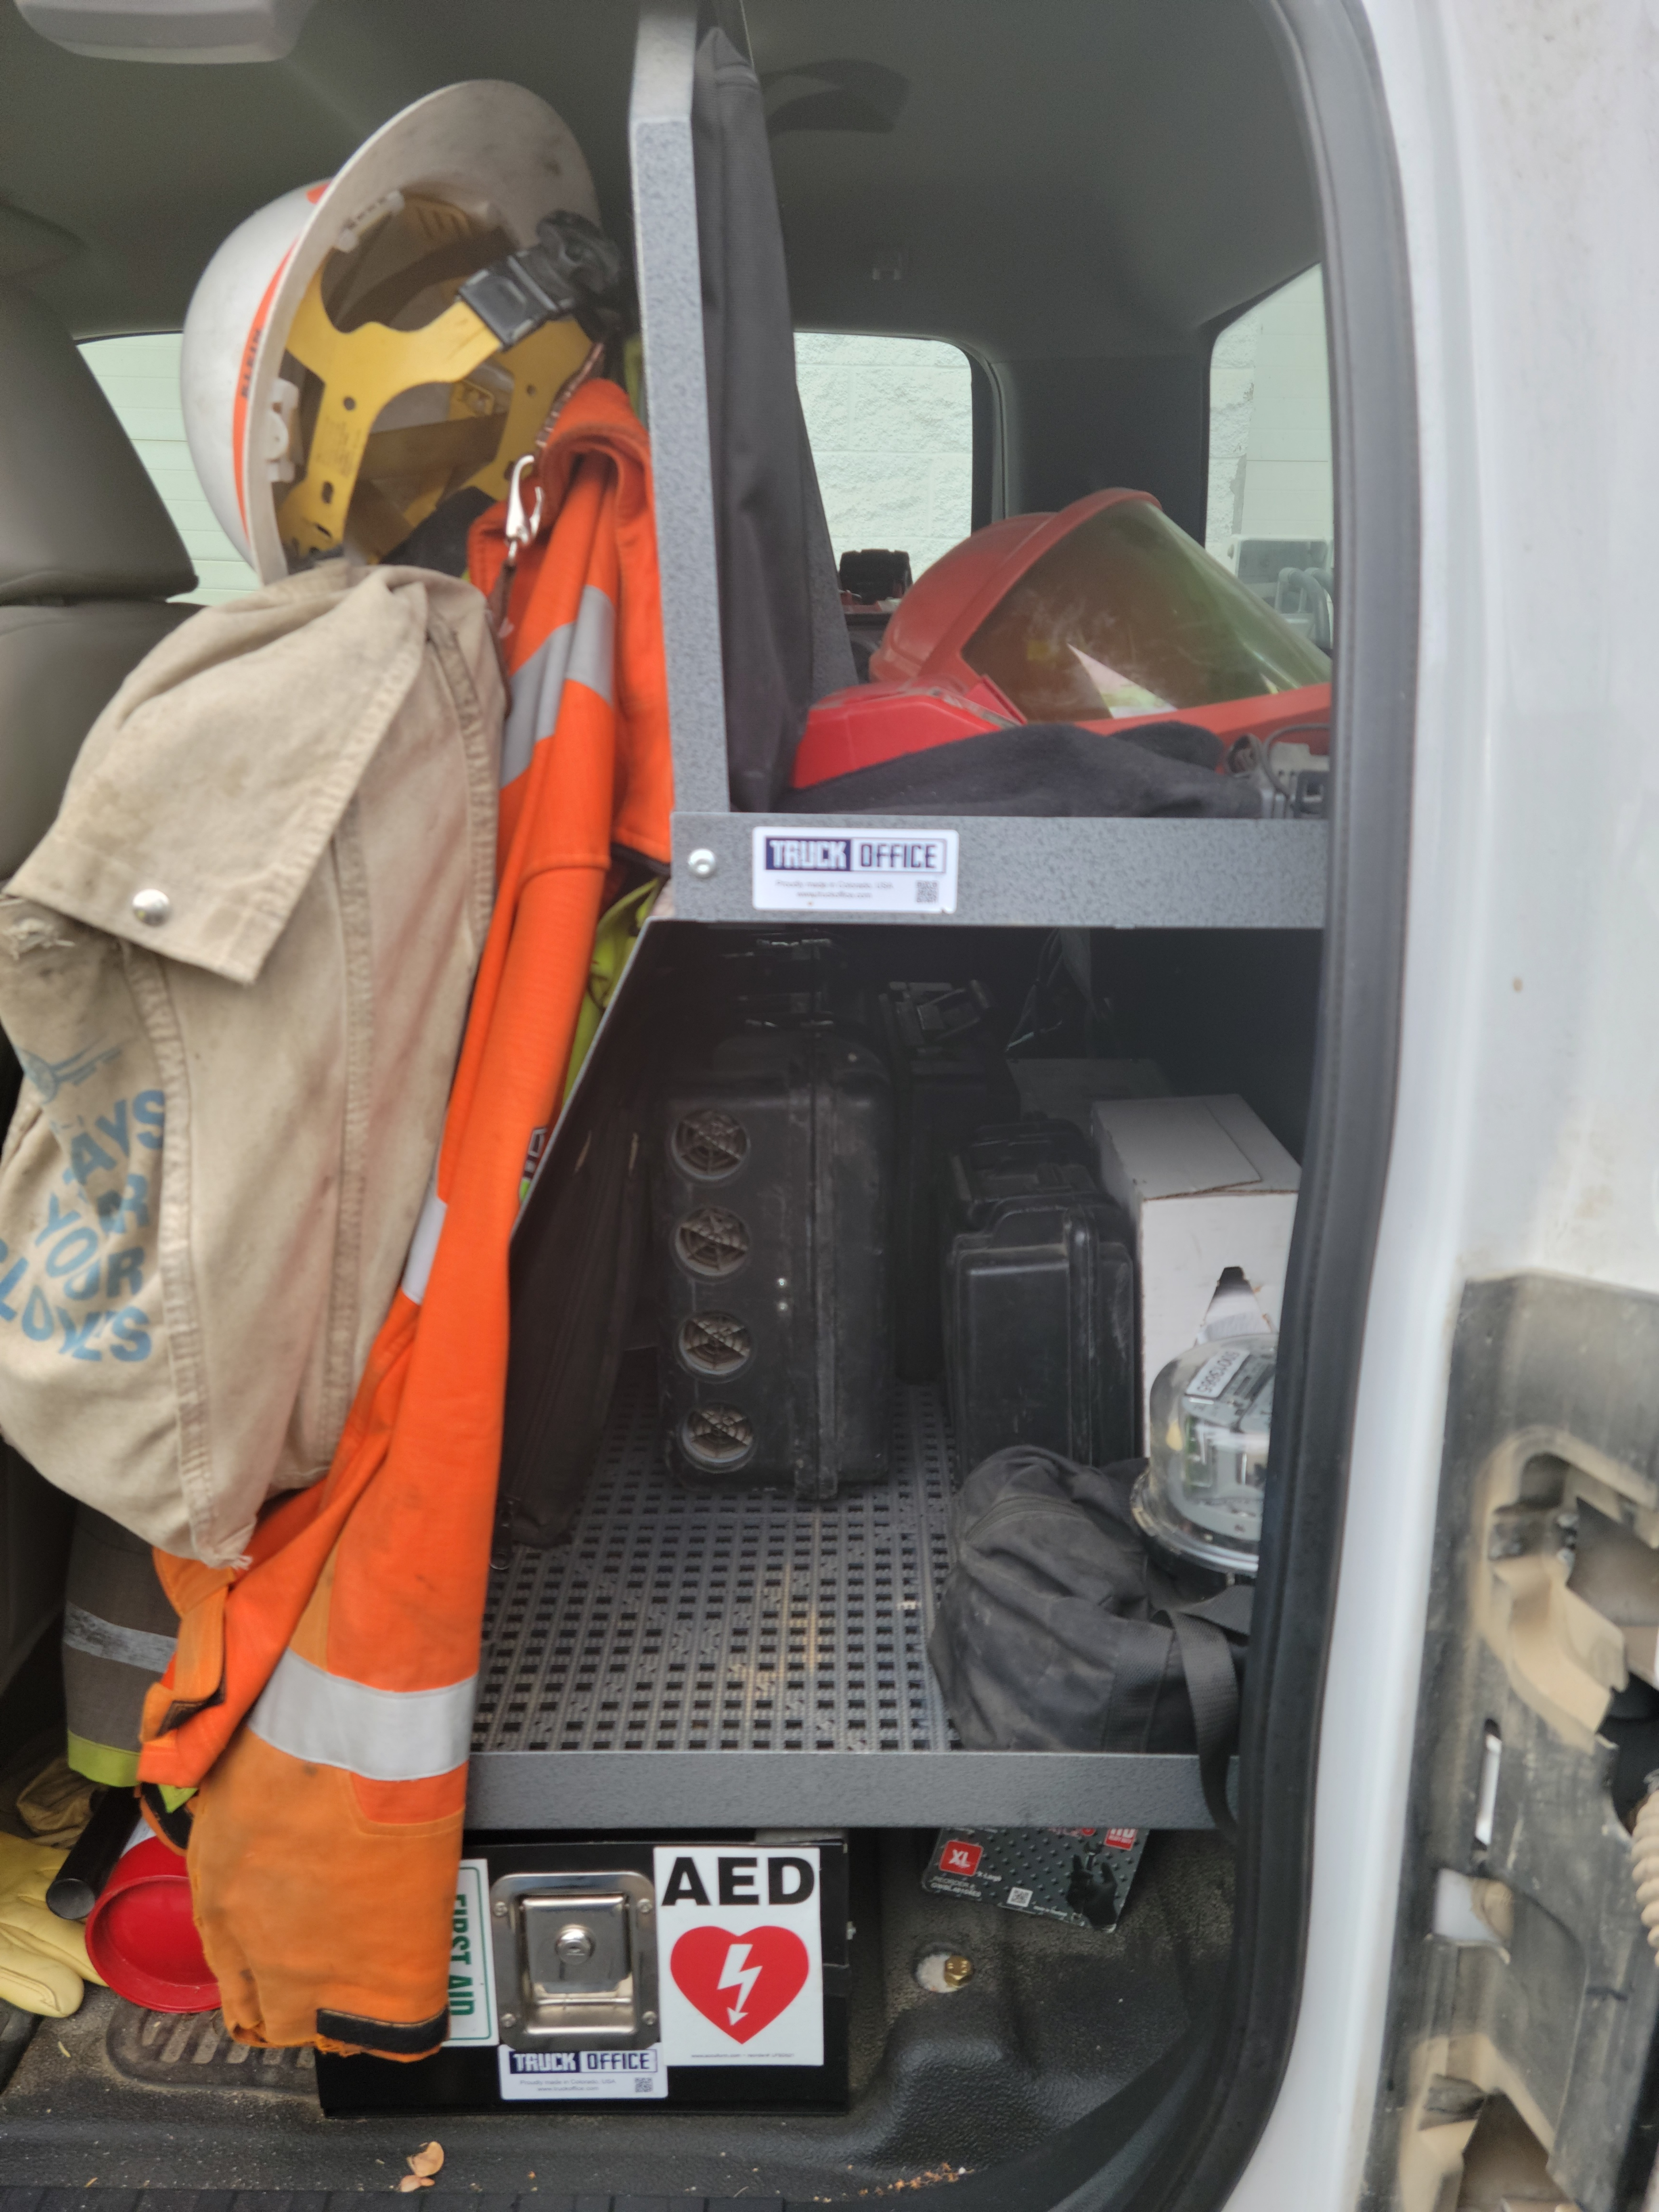

Slide 16
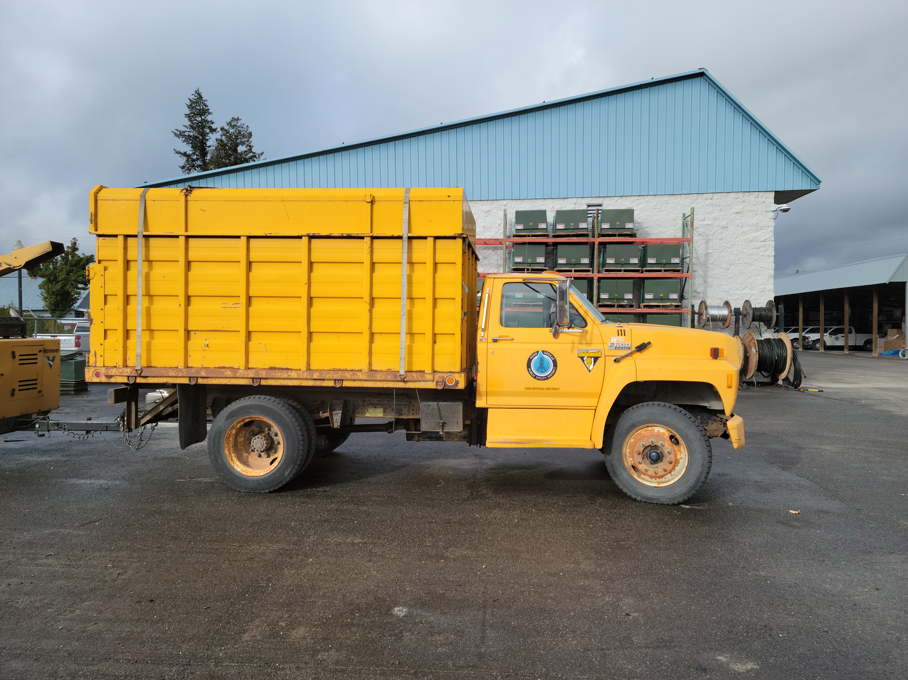
1990

